Slide 1
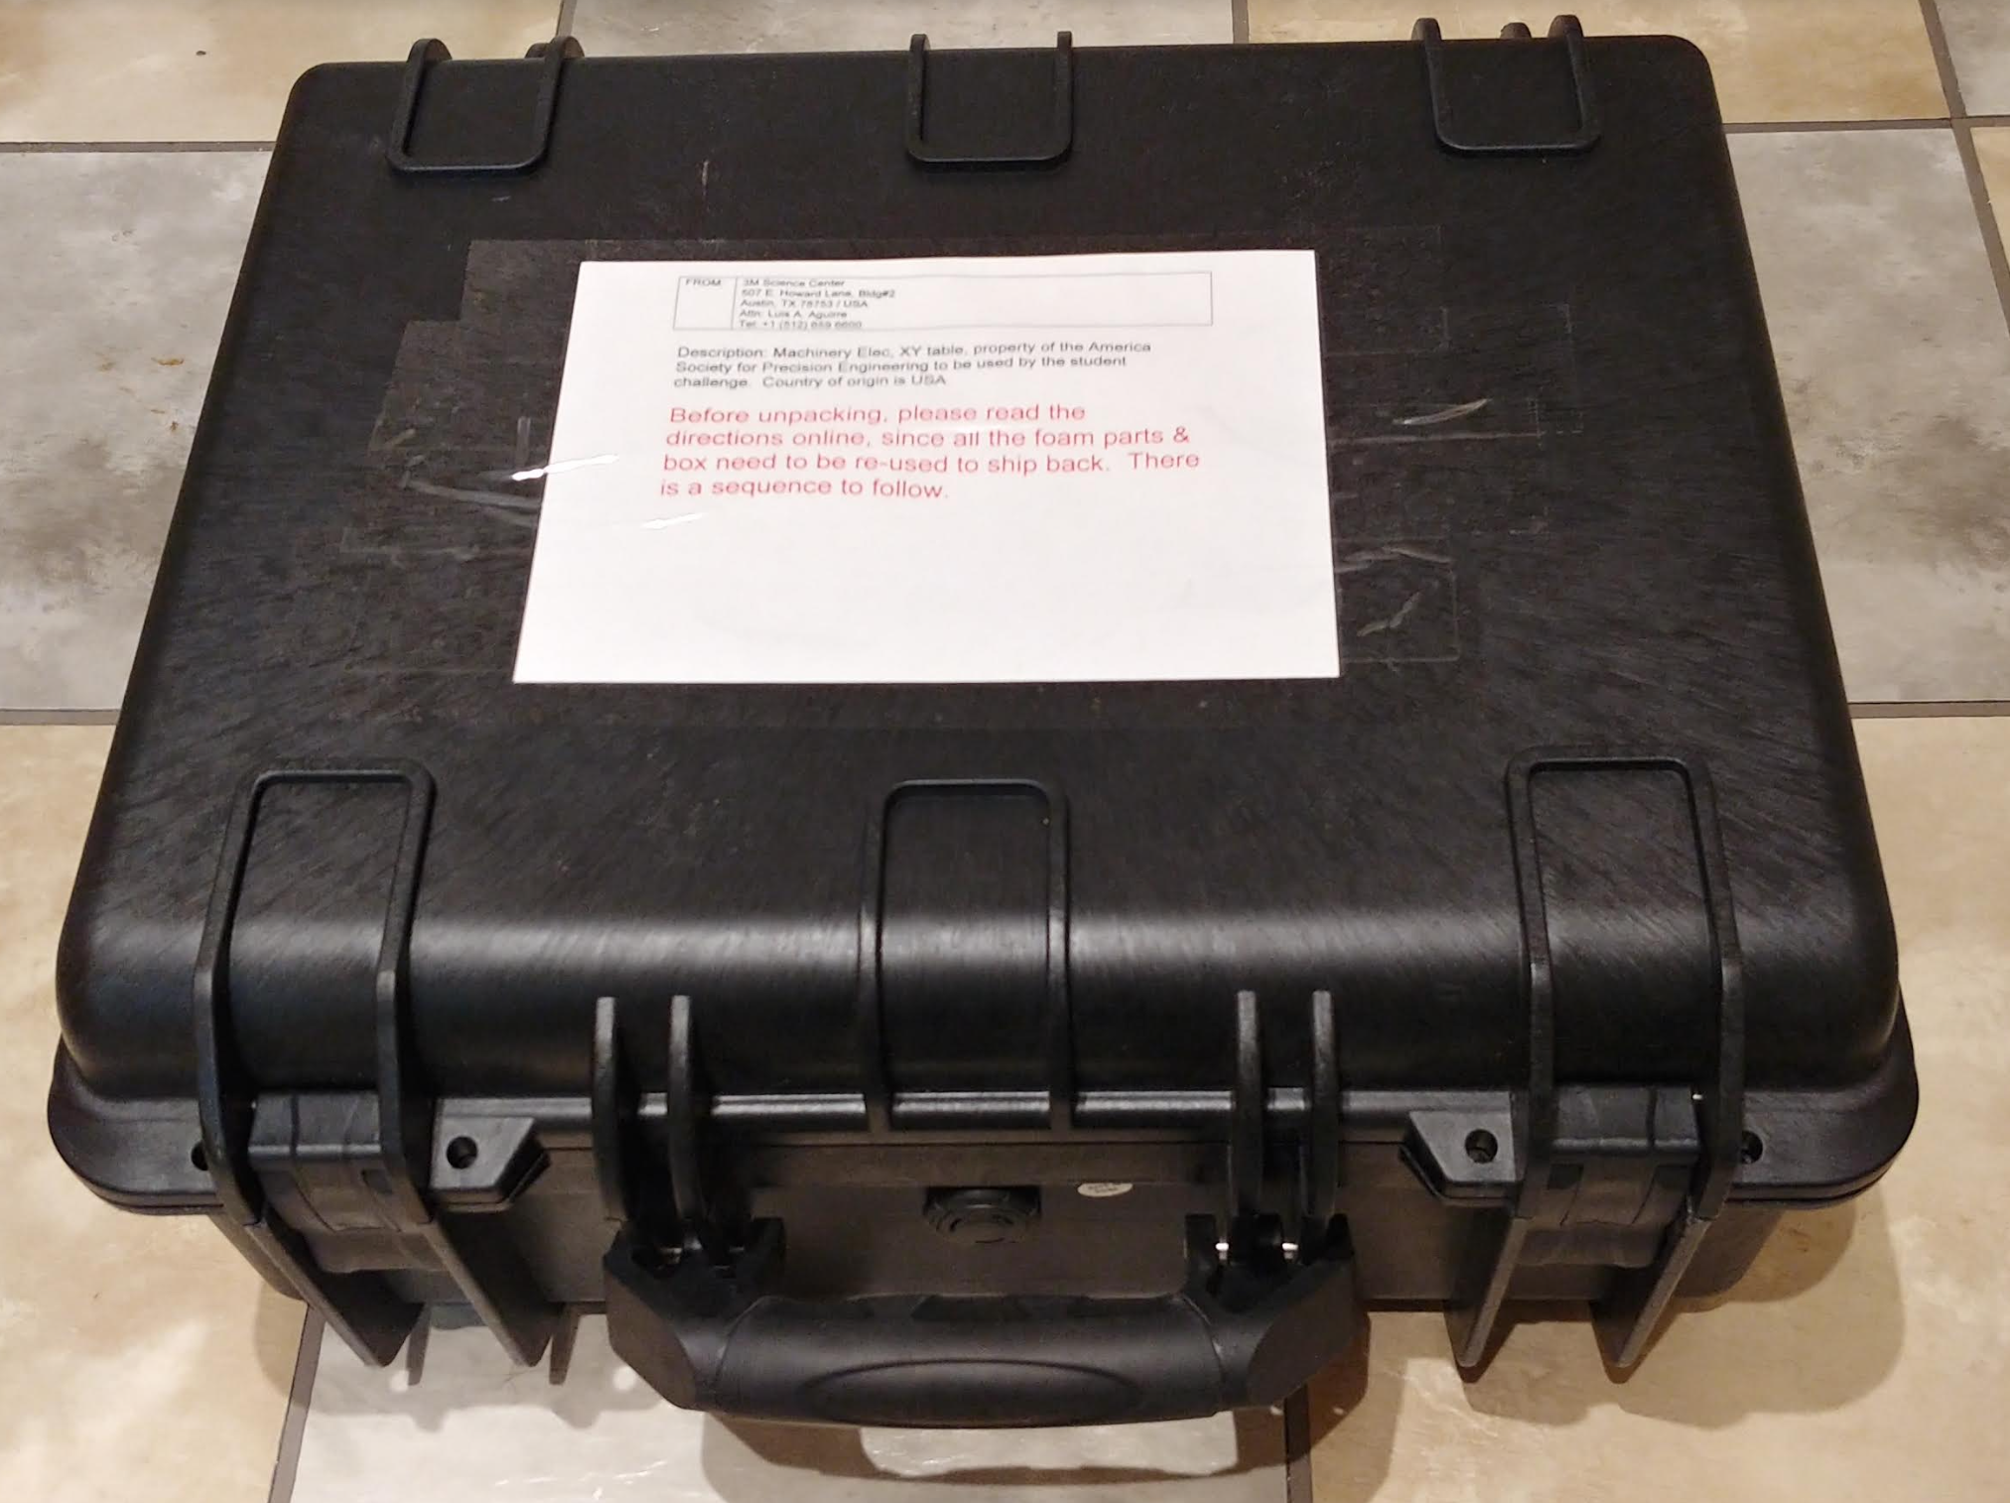
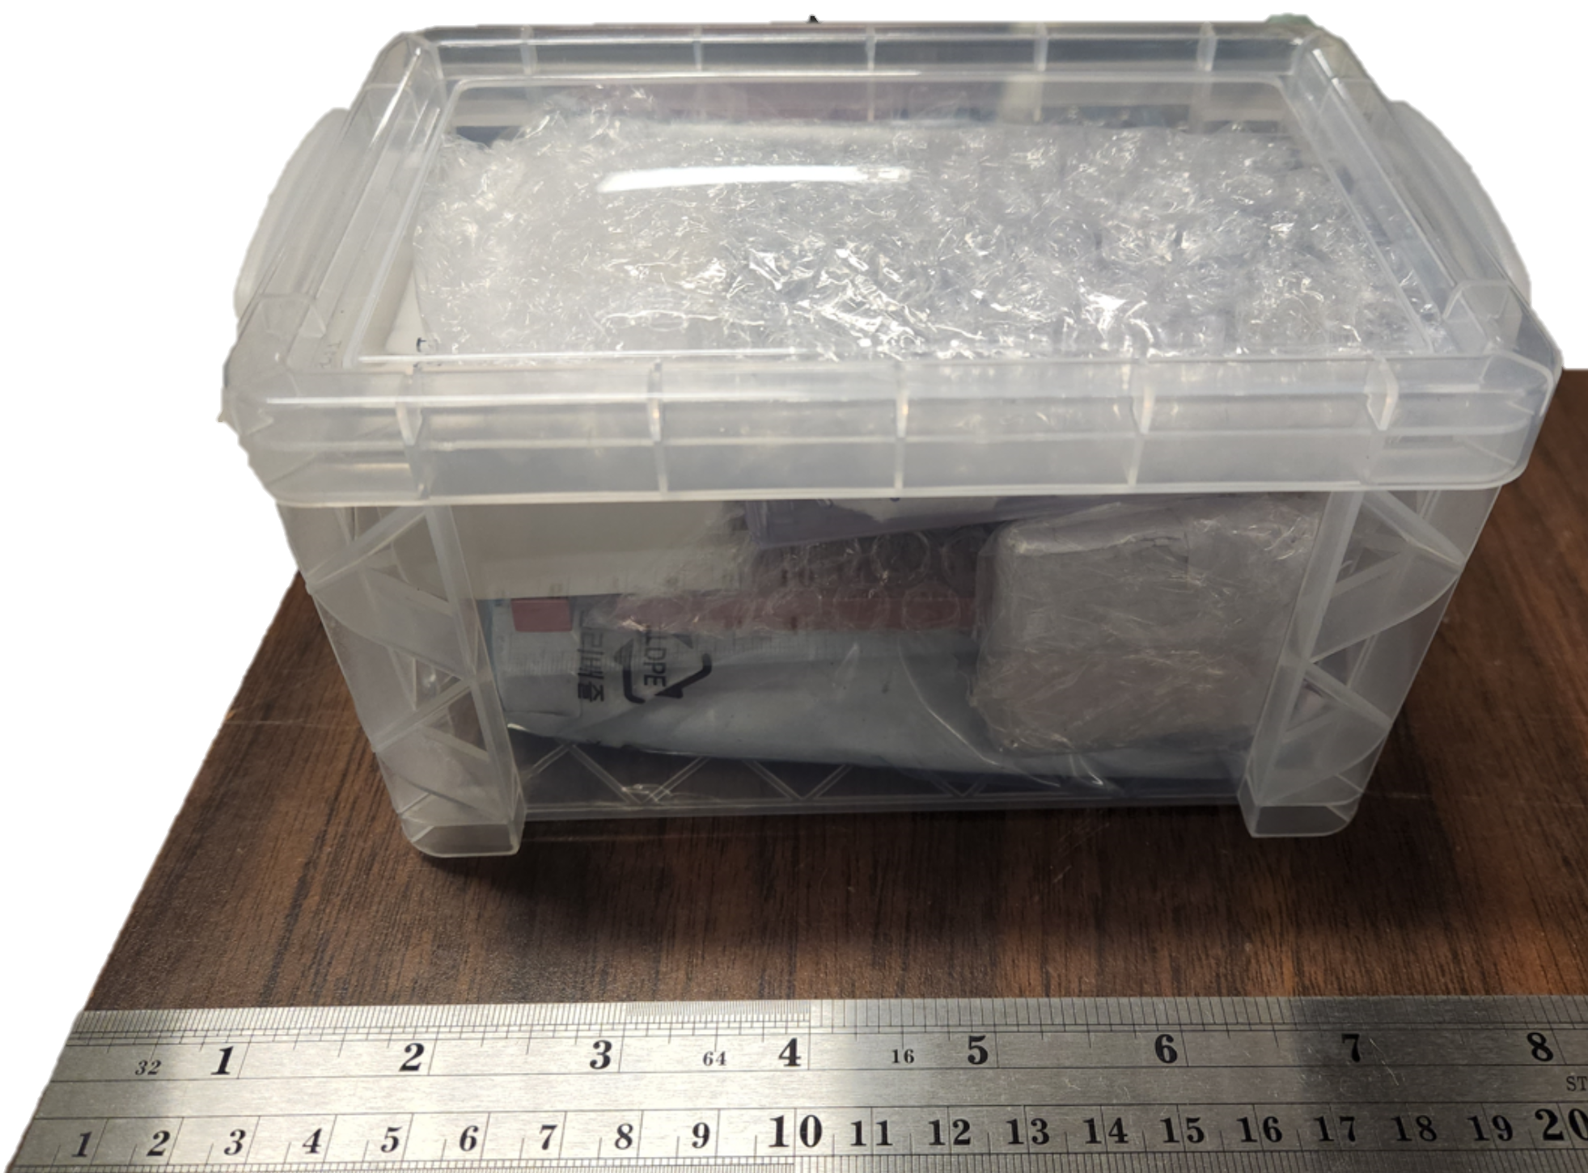
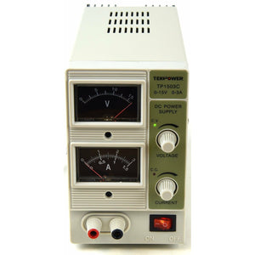
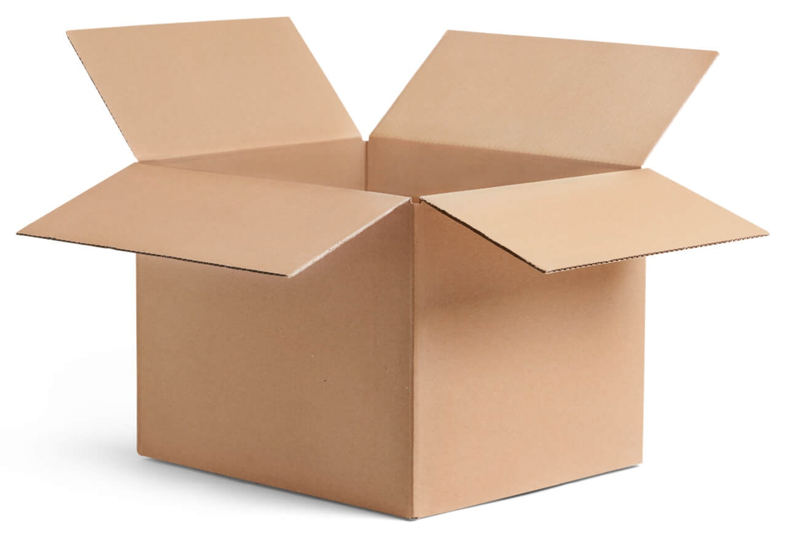
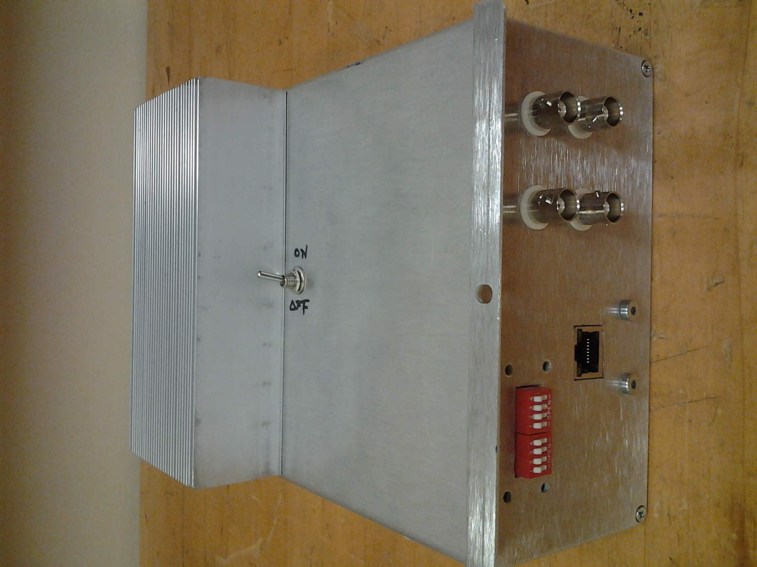

From Luis Aguirre, 3M Austin
From Stuart Smith, UNC Charlotte
OPU, two specimens, Z- axis micrometer stage
Mounting plates and hex screws for all the above
45 pin FFC cable
Shipments
XY air bearing stages with air filter, pressure gage, flow control valve, two-way splitter
PCB with ethernet and DB15 connectors
Ethernet cable
OPU PCB
Power supply cable
Power supplies
DAQ/Amp box
Mech blocks, fastening hardware, clamp and contact plate for the capacitance probe
1 piece ea.: B10-5-0.25-EC, B11-5-1-N, B11-5-5-N, C11-1.5-9.5-N CP10-1-0.5-FL
5 pieces ea.: Threaded inserts (T11-1-M4) and half round washers (W11-1-M4)
20 $ in an envelope
?
Capacitance probe and its signal conditioner

Slide 2
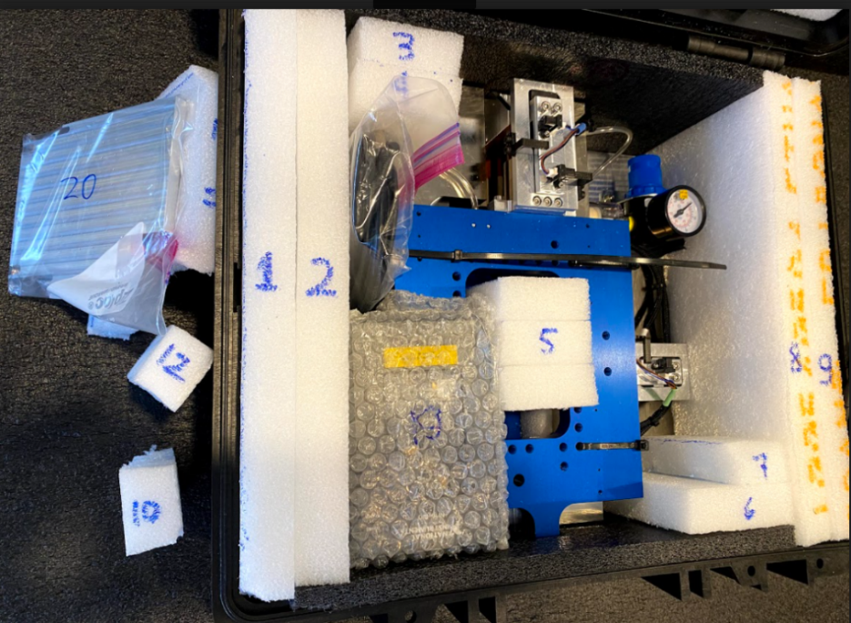
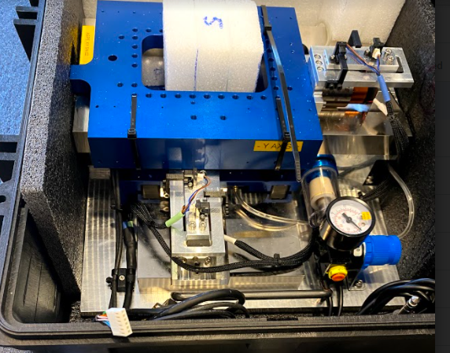
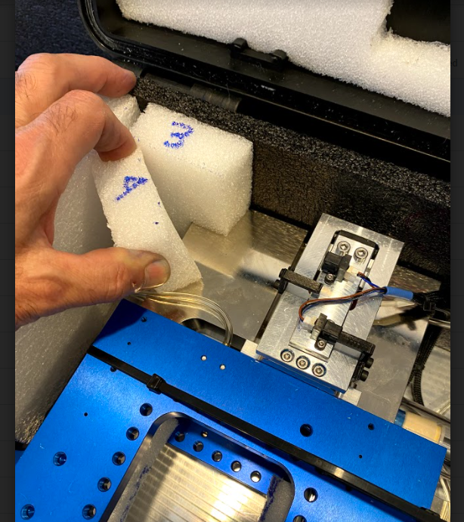
Unpacking the XY stages
Open the cardboard box and extract the black plastic carrying case. Use some help since it is heavy and keep the case horizontal.
Open the plastic case. Take a picture to remember how to pack things back (Let us know if the packing foam did not do its job securing the components). Also, inspect to make sure there are no broken parts.
Right now, do not remove the black foam blocks on the lower and upper edges, and white foam blocks 3 & 4, see image below.
Remove loose parts such as cables, diamond tool, vacuum plate (20), 10 & 12 foam blocks as shown below. Then remove blocks 1 and 2.
Remove foam blocks 3&4 by twisting as shown on the right. Then remove all white foam blocks.
Move the XY stage away to clear the protrusion on the left side (see image below) of the top carriage (shown in blue). After this you can remove the black foam block on the left side of the image.
7. Manually slide the stage towards the left side using the handles on the baseplate, and then pull out the remaining black foam.
8. Using the baseplate handles, lift the stage from the case and put on a bench. Use some help.

Slide 3
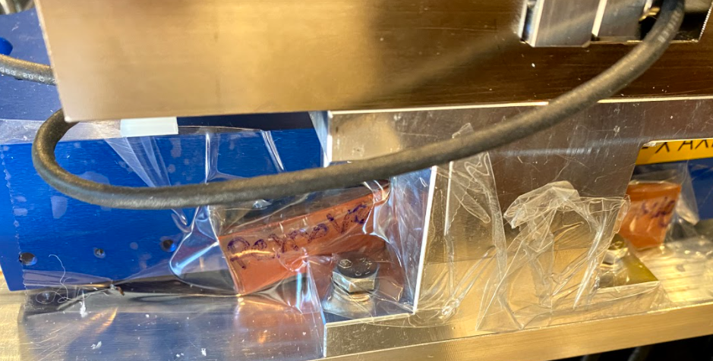
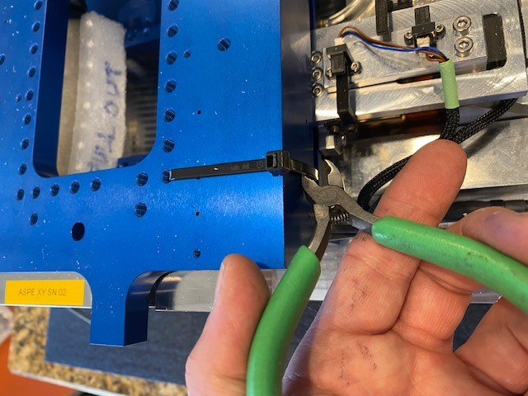
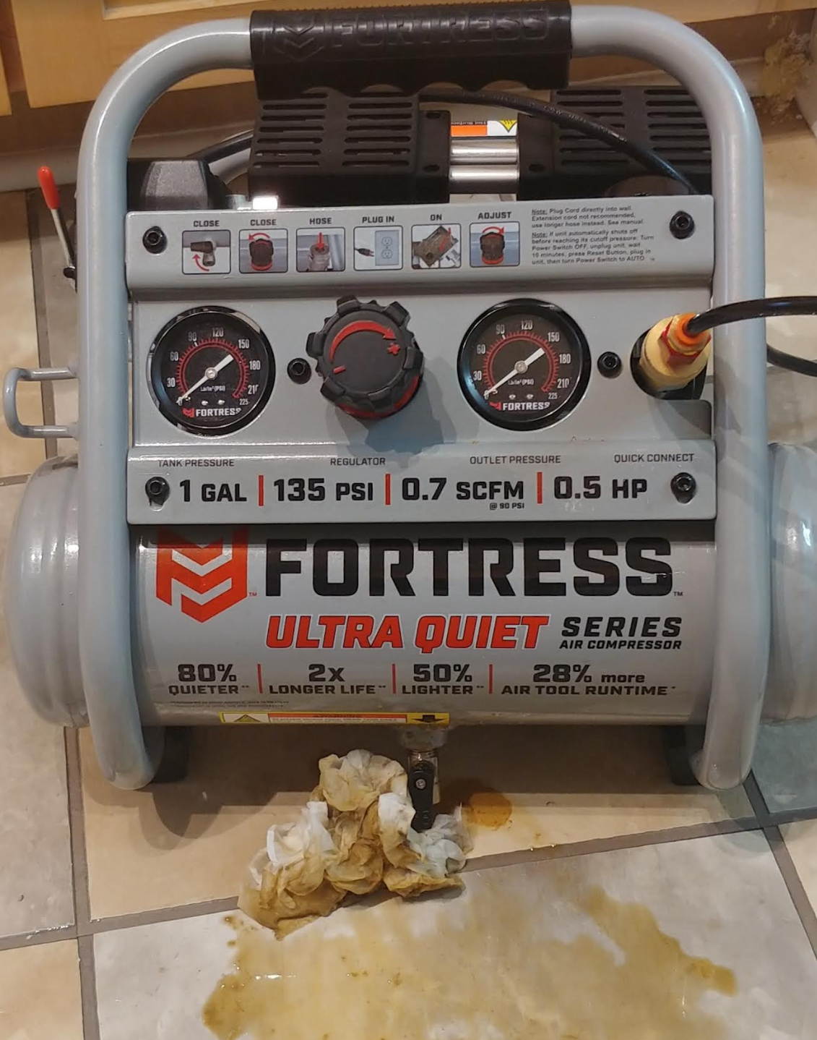
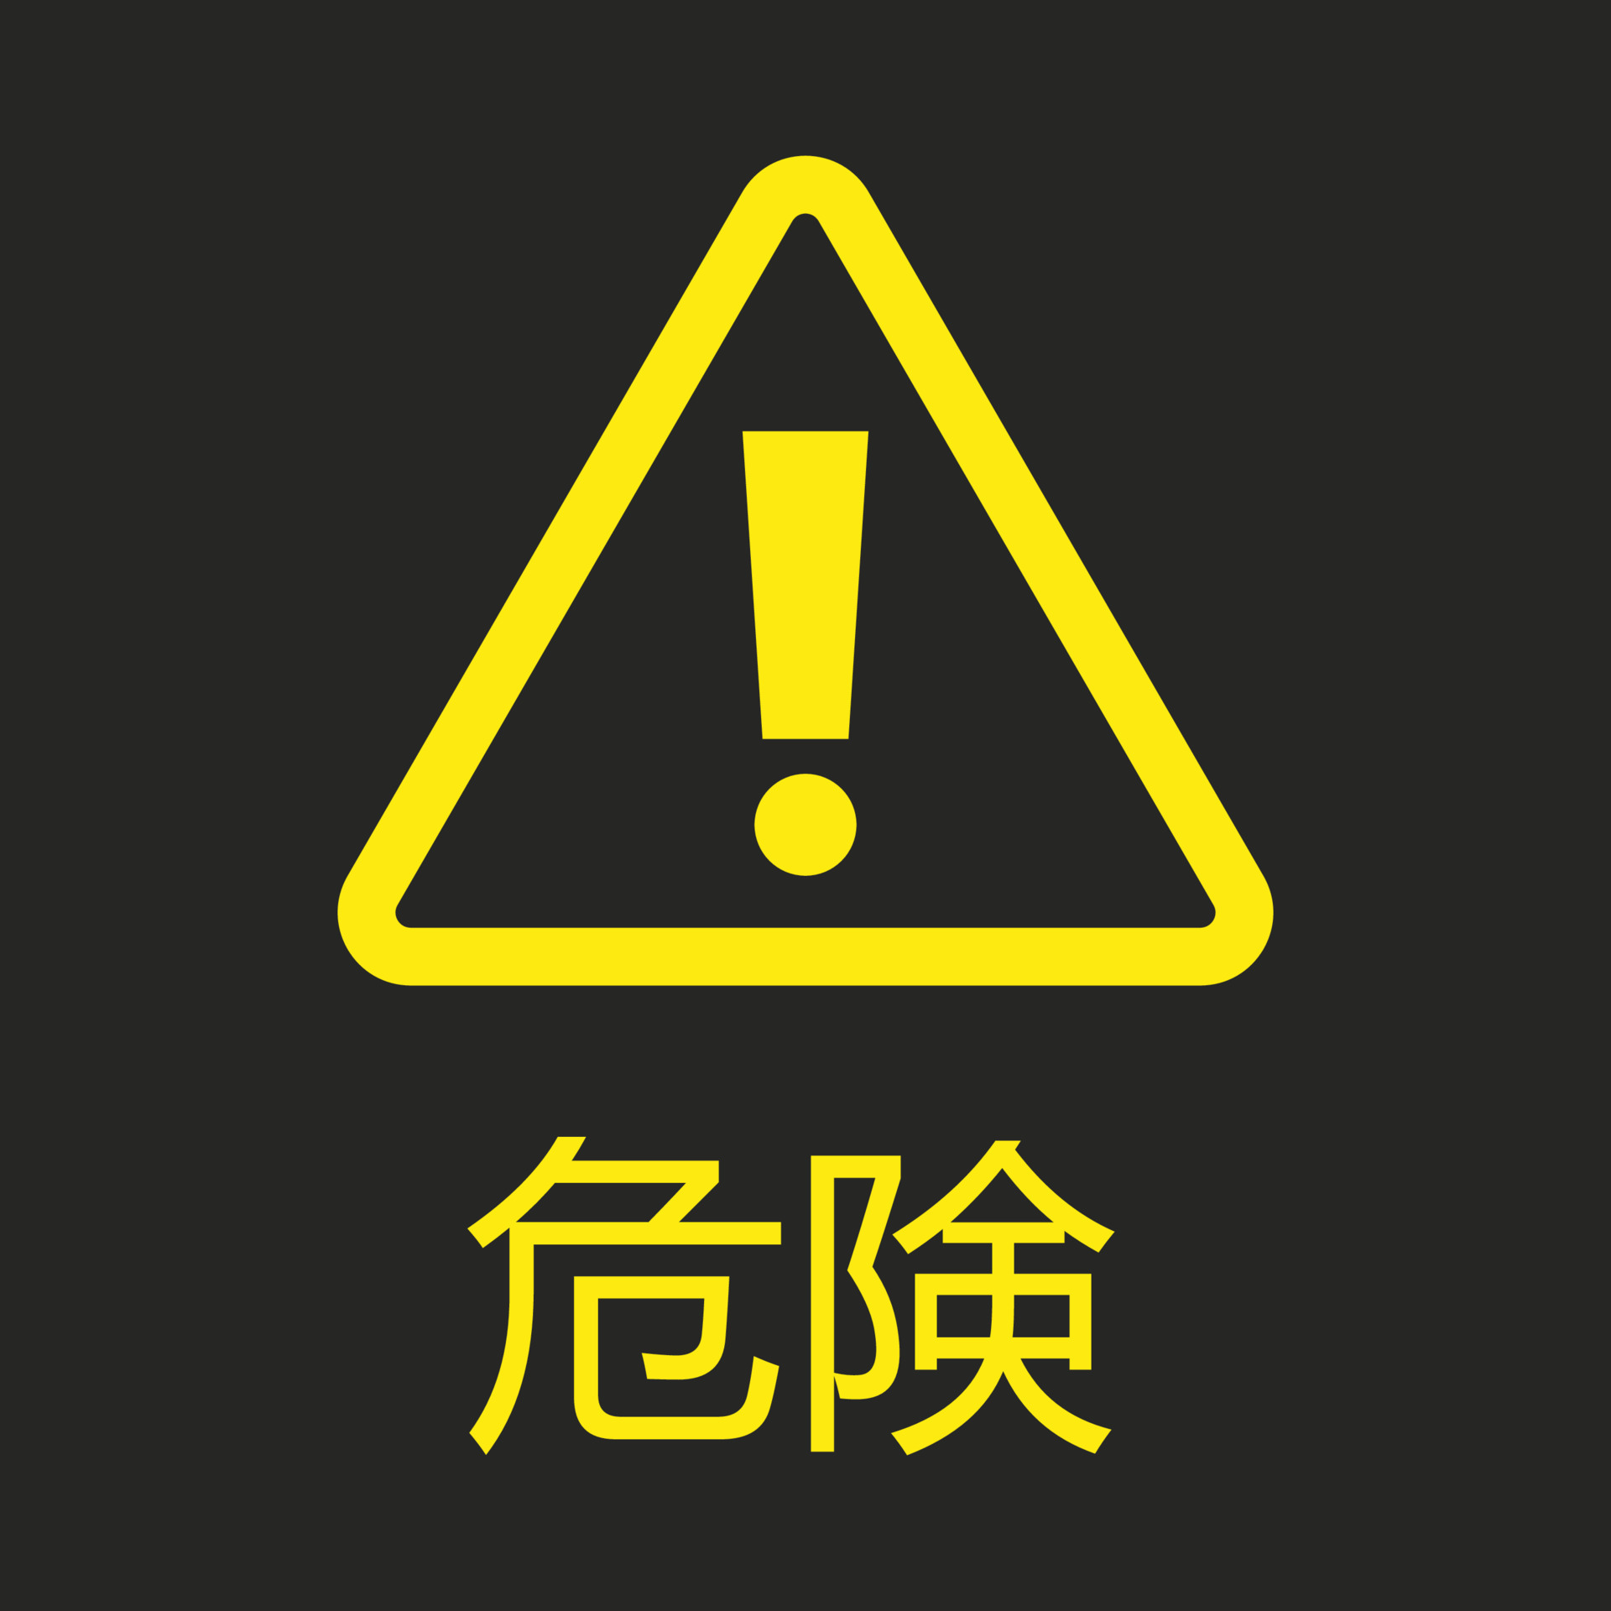
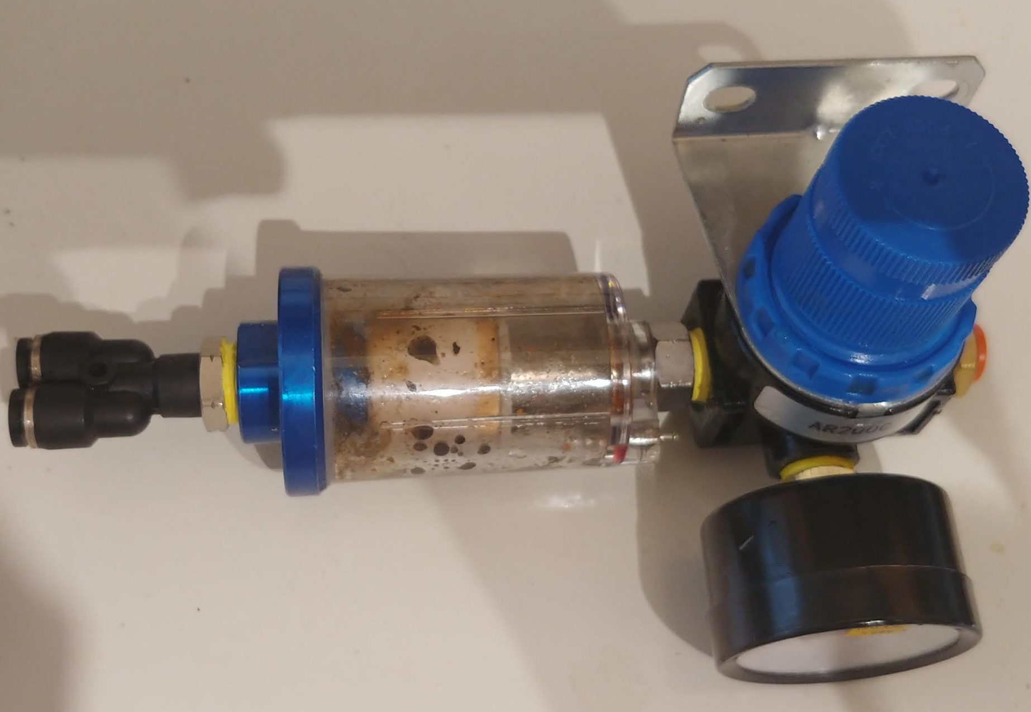
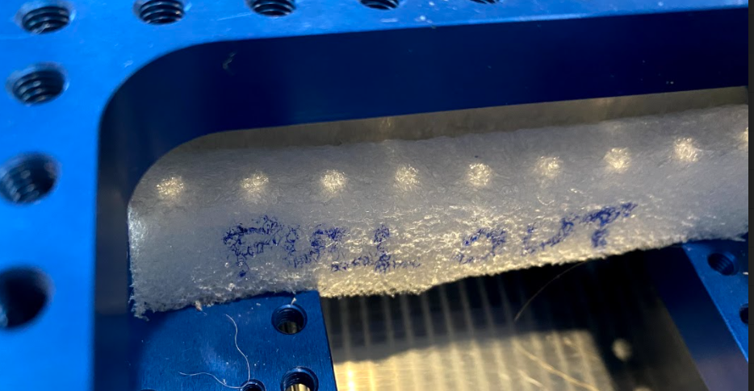
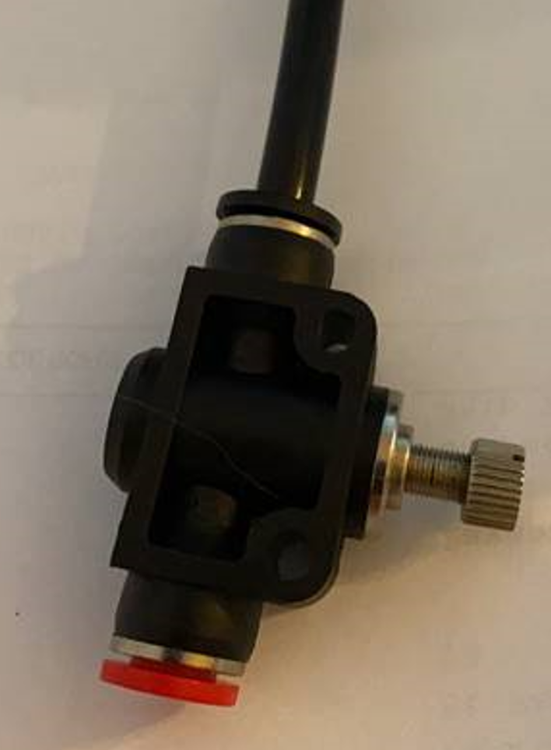
9. On the side of the stage where it is labeled ‘X Axis’, you will see two or four small orange rubber pads as show below. Remove the tape and pull the rubber pads out. Make sure to keep all the components for repacking later.
10. In between the stages there are two pieces of foam. Pull them towards the inside and extract them.
11. Cut cable ties as shown below– avoid scratching the anodization.
12. Connect the small tube and the flow control valve (shown below) to laboratory compressed air supply. Make sure the air supply has a filter that is for 15 um particles or better, as explain in the XY stage Care Instructions (see Appendix A.1).
13. Apply the air and adjust the pressure regulator until X & Y stages move without friction. Assuming the temperature is between 20-25°C stages should move freely around 40-50 psi. When the carriage is not carrying a high load, the ideal operating pressure is 60 psi. Make sure to keep the pressure to less than 75 psi in any case.
If using compressor, drain it everyday
If you don’t ☹

Slide 4
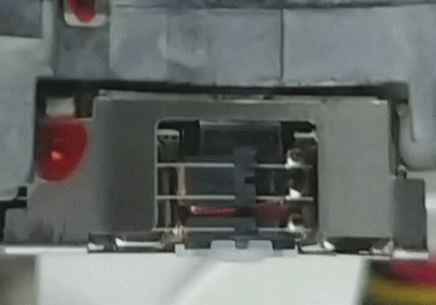
Suggested workflow after you receive the shipments
Install LabVIEW following the procedure given in slides at the end, and use the files in GitHub
2. Watch the LabVIEW + Student challenge 2022 hardware YouTube tutorials
3. Use following slides and tutorials to setup hardware communication, power supply, setup the XY stages, OPU and capacitance probe.
It is preferred to use the concave mirror as the reflective object to setup the hardware to avoid damage to the ‘Team Alvarez mirror’.
Do not bring any ferrous material in front of the OPU lens. There are magnets inside the OPU and would cause damage.
4. Once confident about scanning setup, you can choose to do the following tasks in the order you prefer
Use one or more of the calibration equipment (capacitance probe, micrometer stage, concave mirror) to convert OPU lens travel commanded in volts (equivalent current driven through the coil) to metric.
Areal measurement of the concave mirror
5. Areal measurement of the Team Alvarez mirror
6. Can use CAD files in GitHub for design modification and presentation purposes, and example Matlab codes for data processing
S
Meandering
Rastering
z
- V, - I
V, I
Parallel guidance Wire flexures
Focusing lens

Slide 5
What changes can you make to the provided equipment and measurement process ?
Literally anything that can be removed while handing over the equipment (with no damage) back to the committee.
These modifications may include but not limited to
Damping treatments (removable)
Mounting of OPU, z-axis micrometer stage etc.
LabVIEW program
Measurement procedure
Meandering, rastering, etc.
PID controller gains of OPU and XY stages
If you wish, you don’t even have to use a PID controller for the OPU and use a different controller strategy
Data storage
Teams can use additional components of up to 50 $, after obtaining permission from the committee. For example, use of additive or conventionally manufactured bespoke component, will include the cost of the machine. Therefore >>>50 $

Slide 6
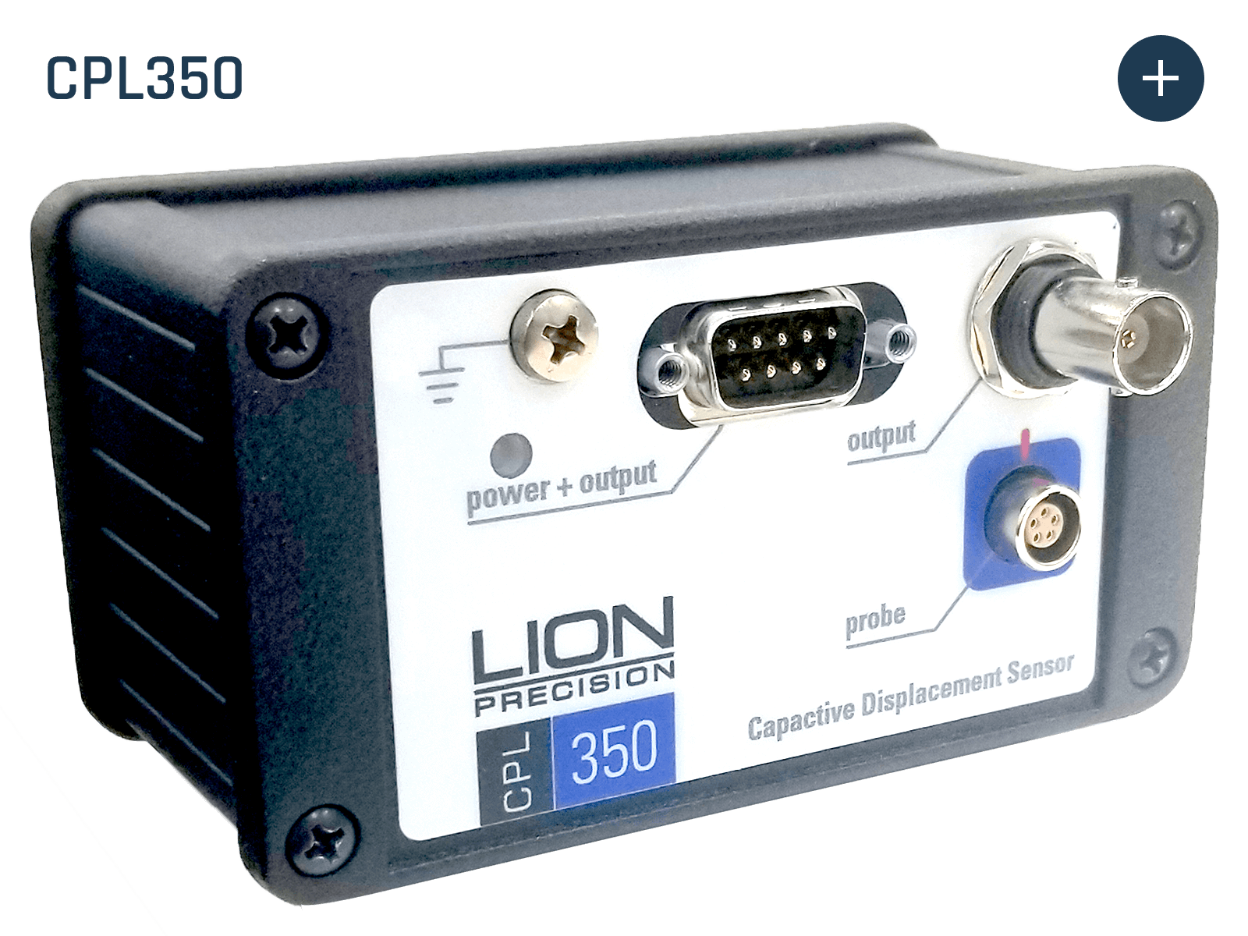
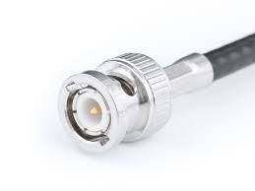
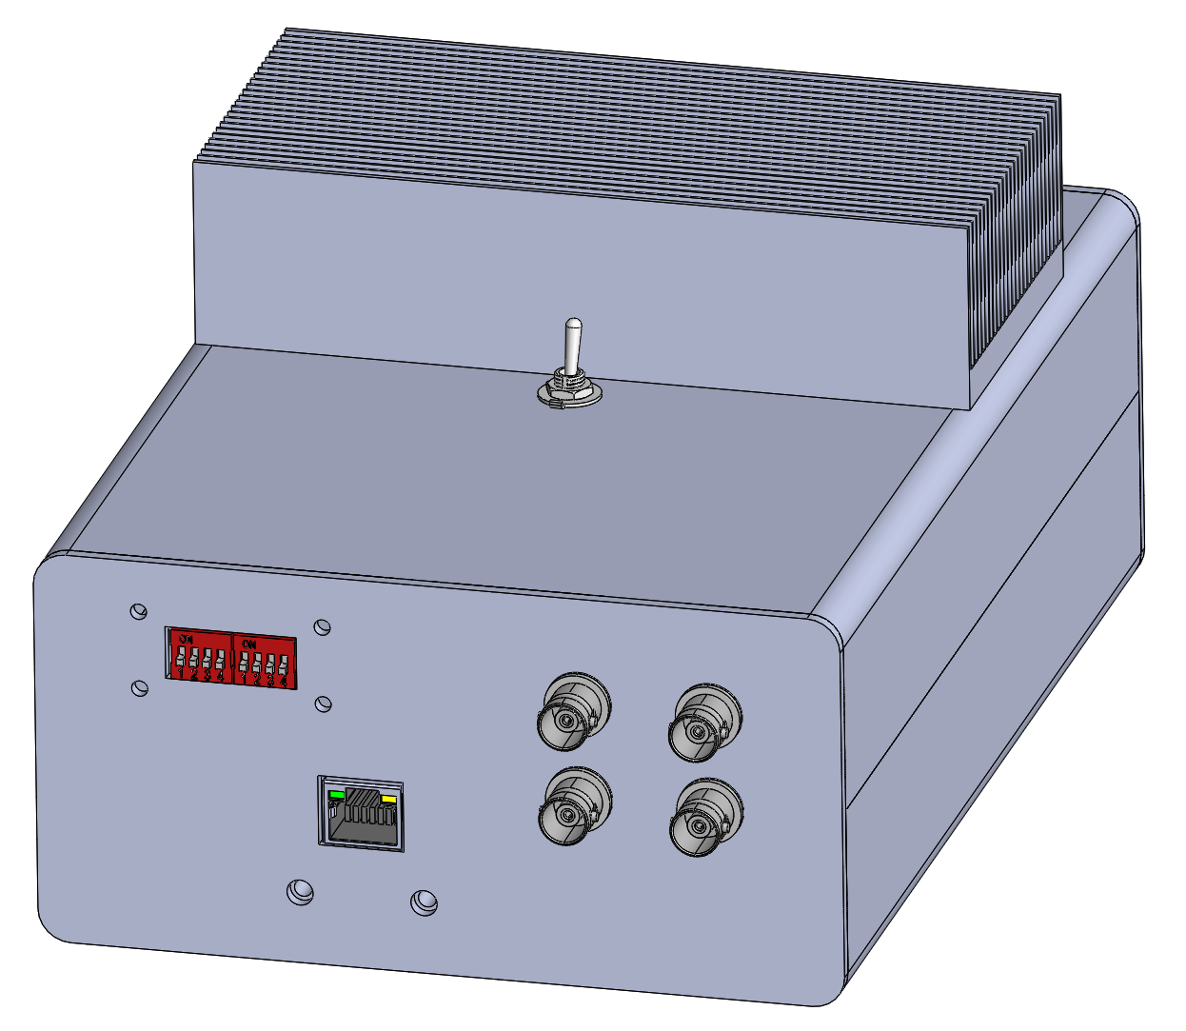
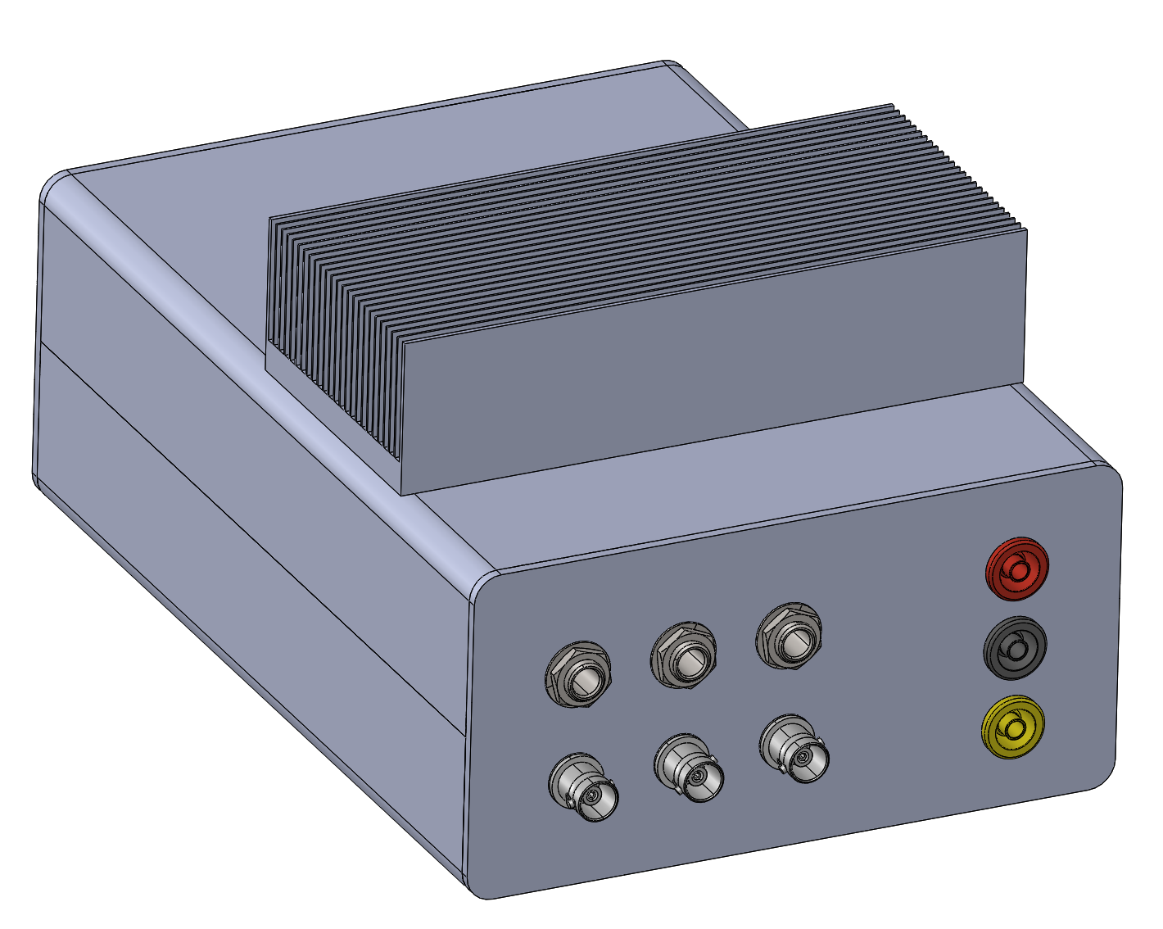
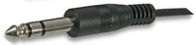
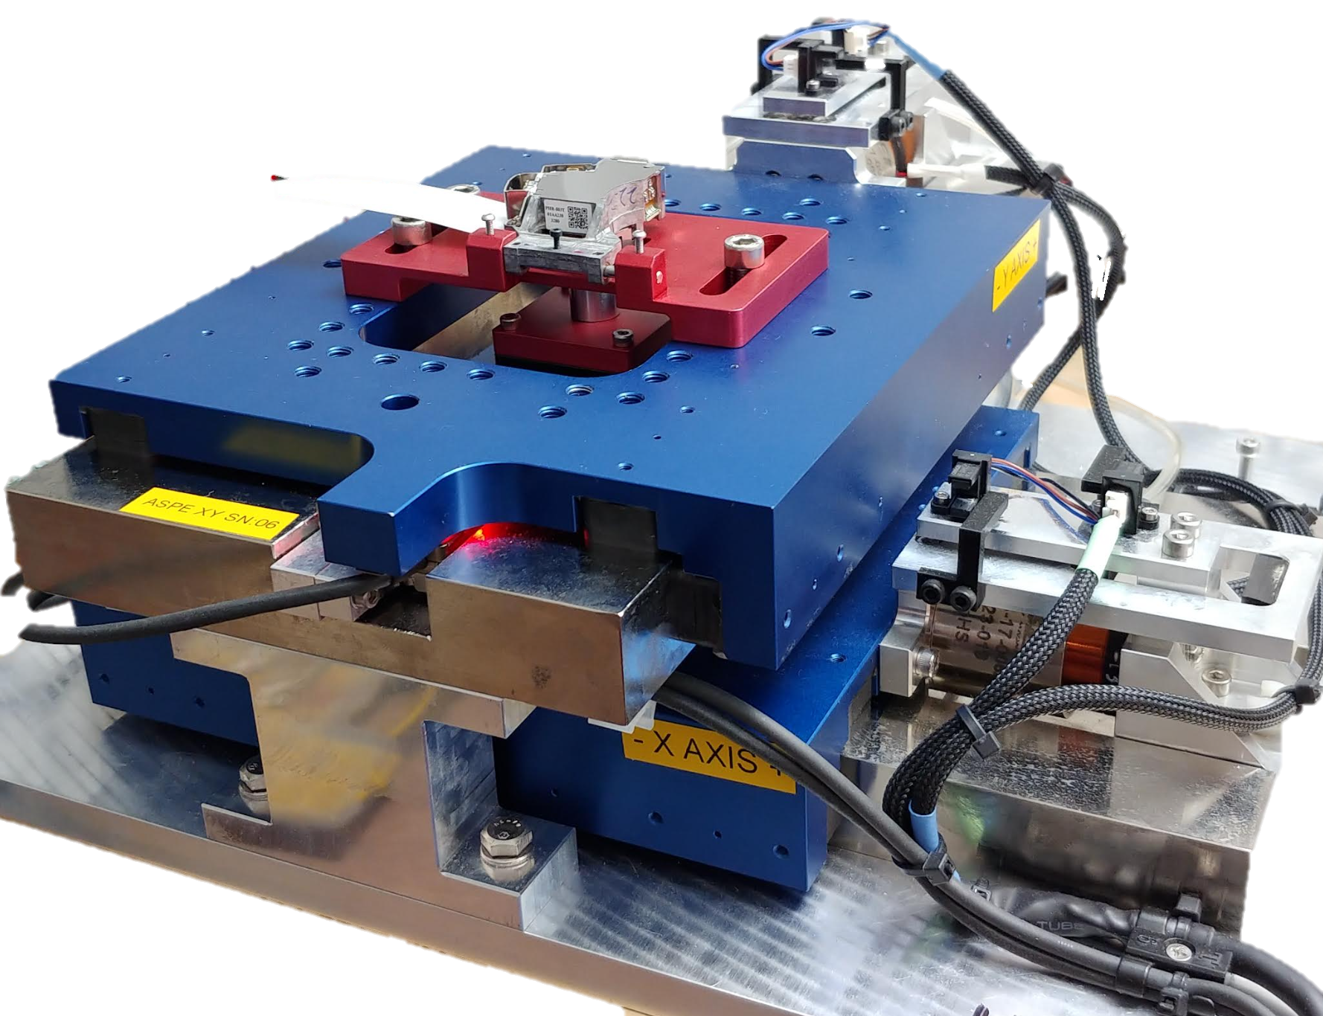
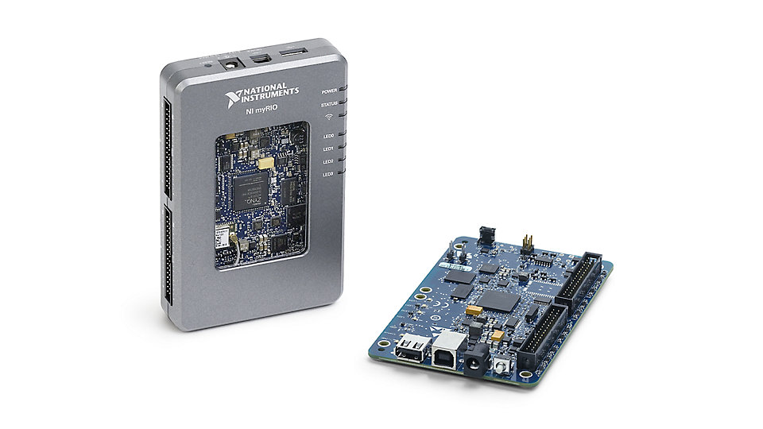
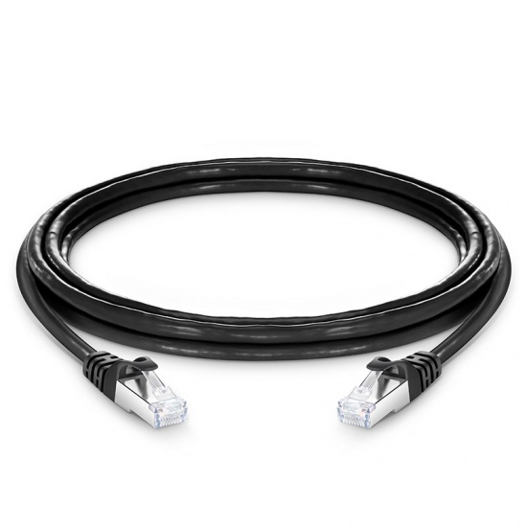
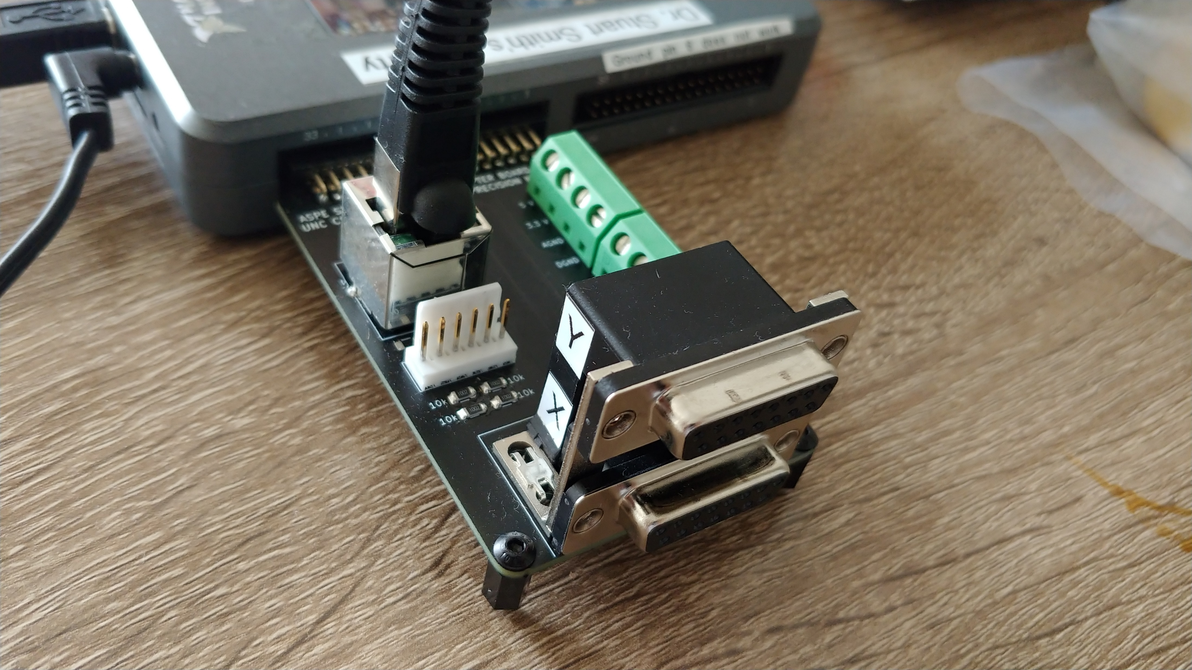
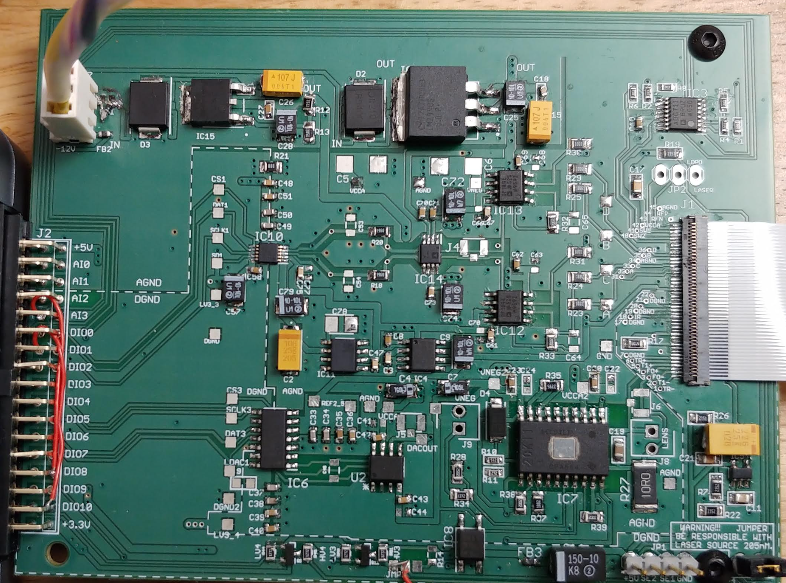
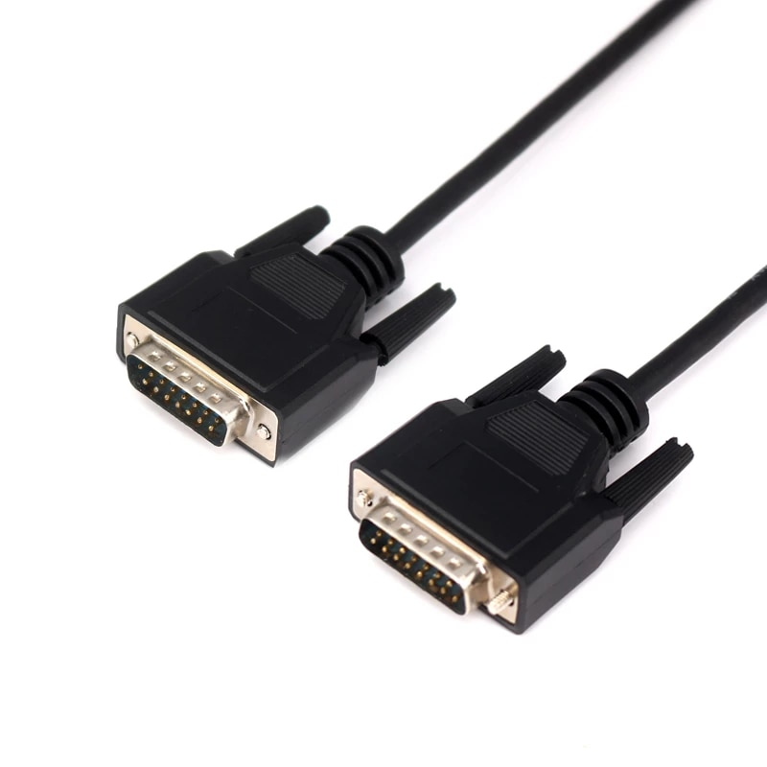
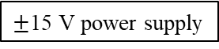
Lion precision capacitance gage
Hardware communication
X, Y voice coil Jack plugs connects to AMP 1 & AMP 2 on the unit
$±$15 V power supply
BNC cable connects to ADC 1 of the DAQ unit
NI-myRIO microcontroller
DAQ/AMP unit
A
B
Shielded ethernet cable
Optical limit switches connected to 6-pin Molex connector
B
A
PCB connector block for encoders, limit switches, and DAQ communication. Goes to connector A of myRIO
DB15 connectors to read linear encoders of X, Y stages
PCB for the OPU

Slide 7
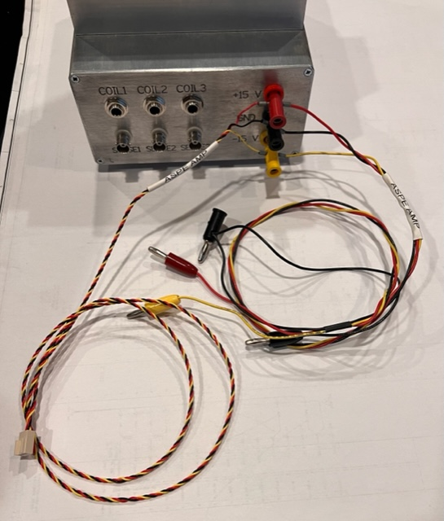
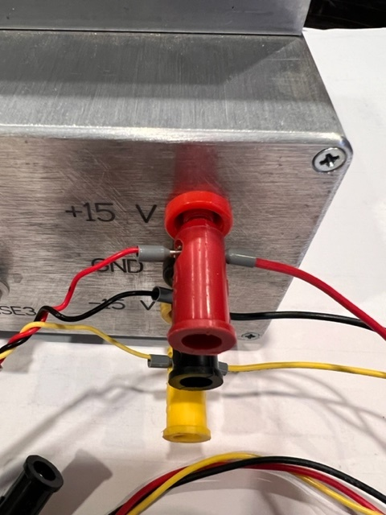
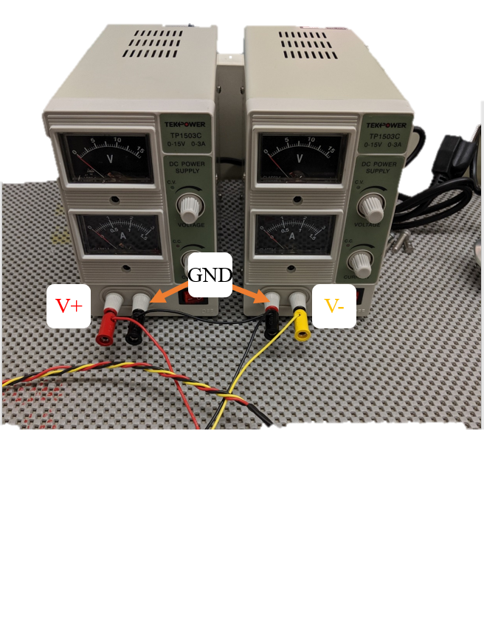
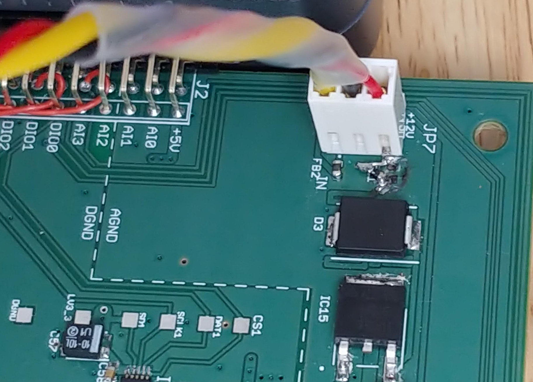
Power supply cabling
The diodes inside the DAQ/AMP unit protects the OPU PCB. Therefore, the power supply gets split here, before connected to the PCB using a Molex connector
Tekpower TP1503C
GND
+15 V
-15 V
Molex connector goes to the OPU PCB

Slide 8
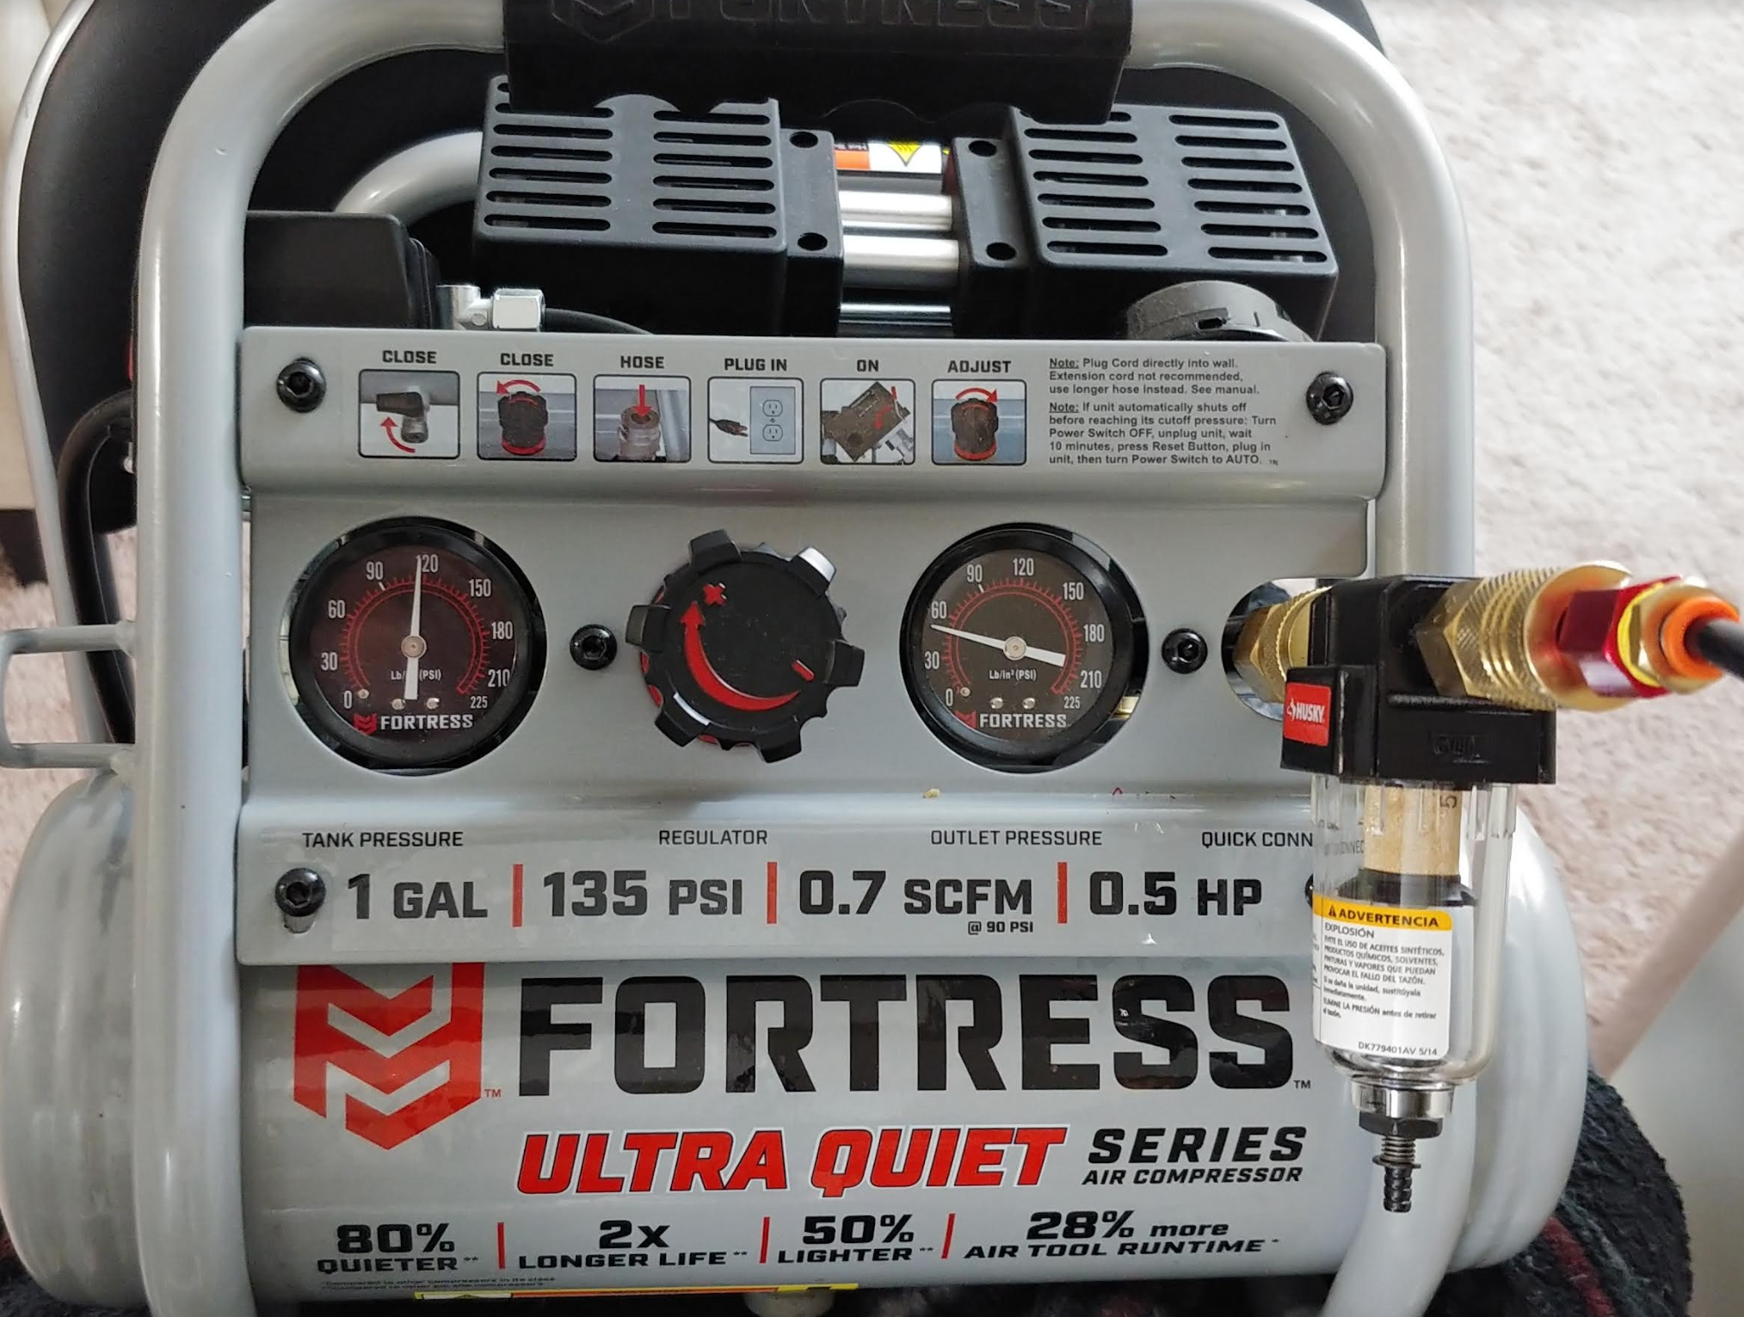
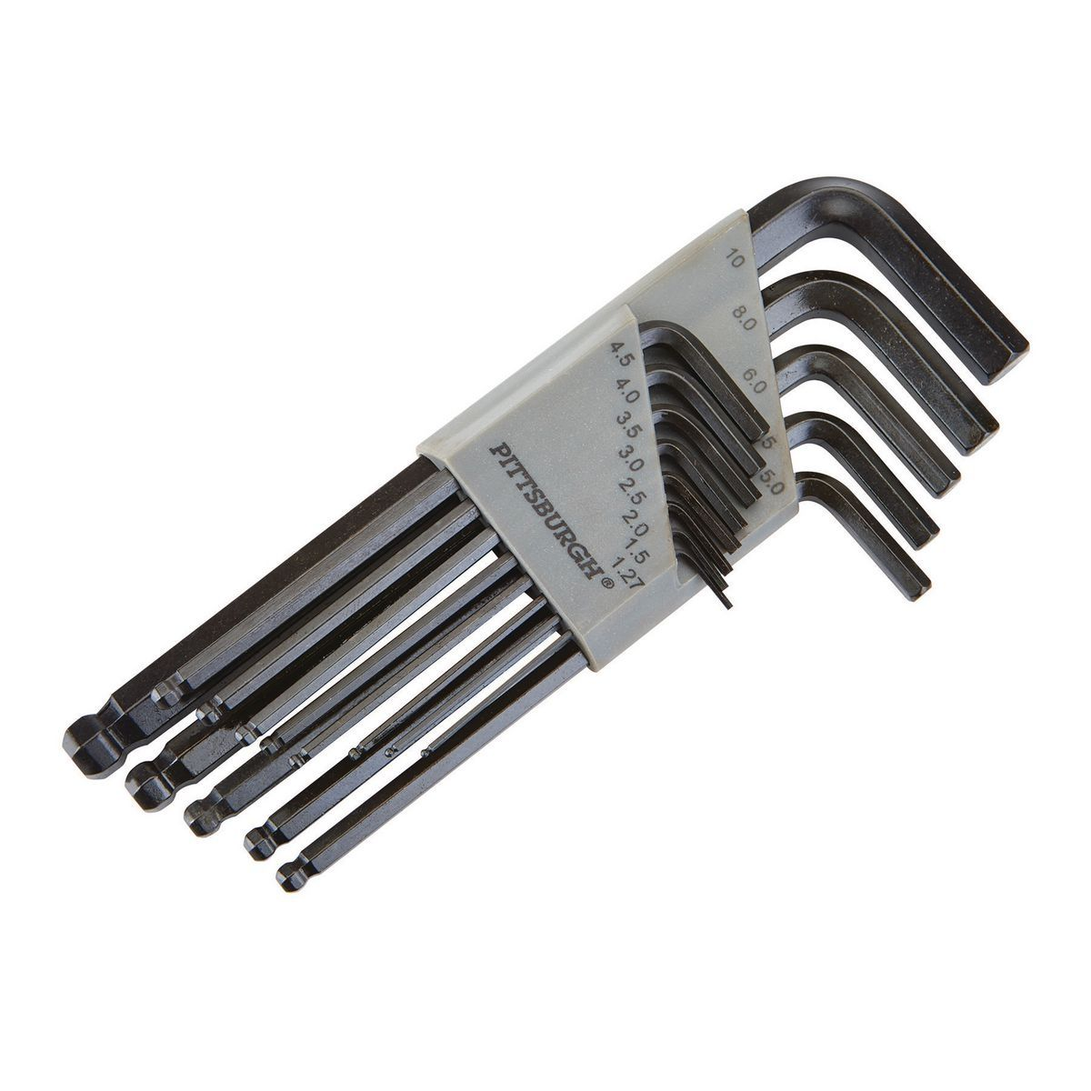
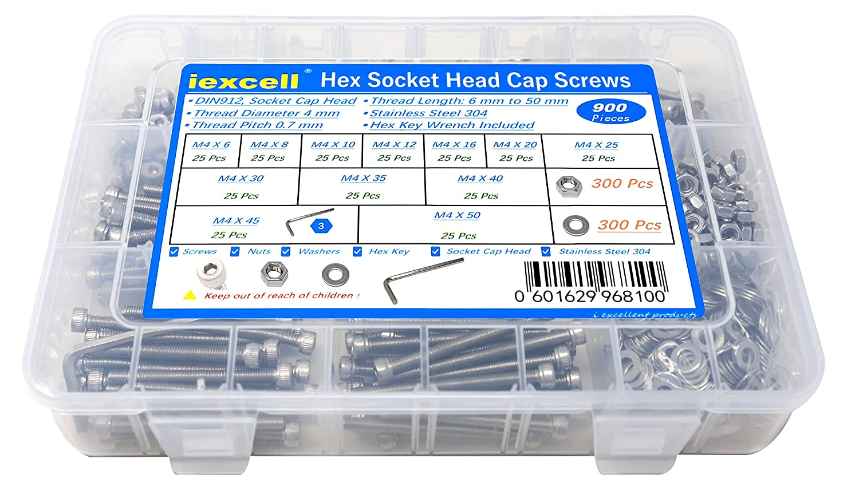
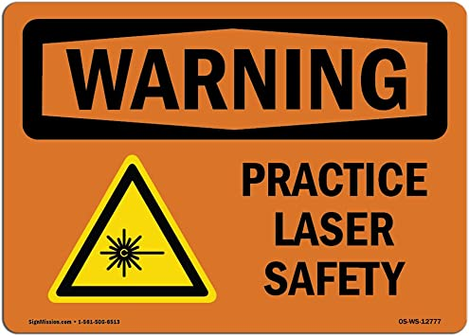
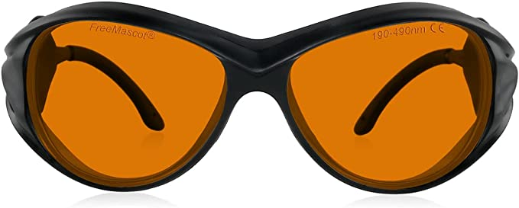
Teams must possess
NI-myRIO microcontroller
If you do not have a filtered air supply in your laboratory at 50 psi. you need an air compressor
Metric hex key set
If using air compressor, use another stage of filtering. Stages come with a flow controller, a pressure gage, and an air filter. Make sure the compressor has a filter is rated to filter out least 15 µm particles
M4 screws if using Mechblocks
UV laser safety glasses if you intentionally watch the laser reflecting from the specimen
If you do not have access to these equipment, the challenge committee might be able to arrange on a case-by-case basis.

Slide 9
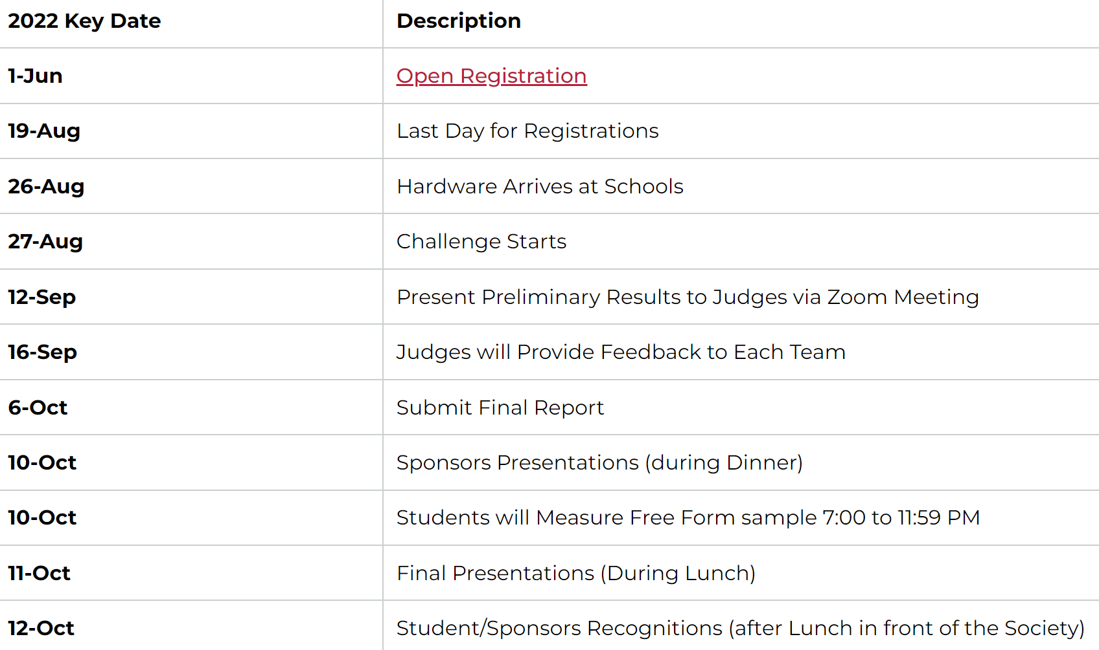
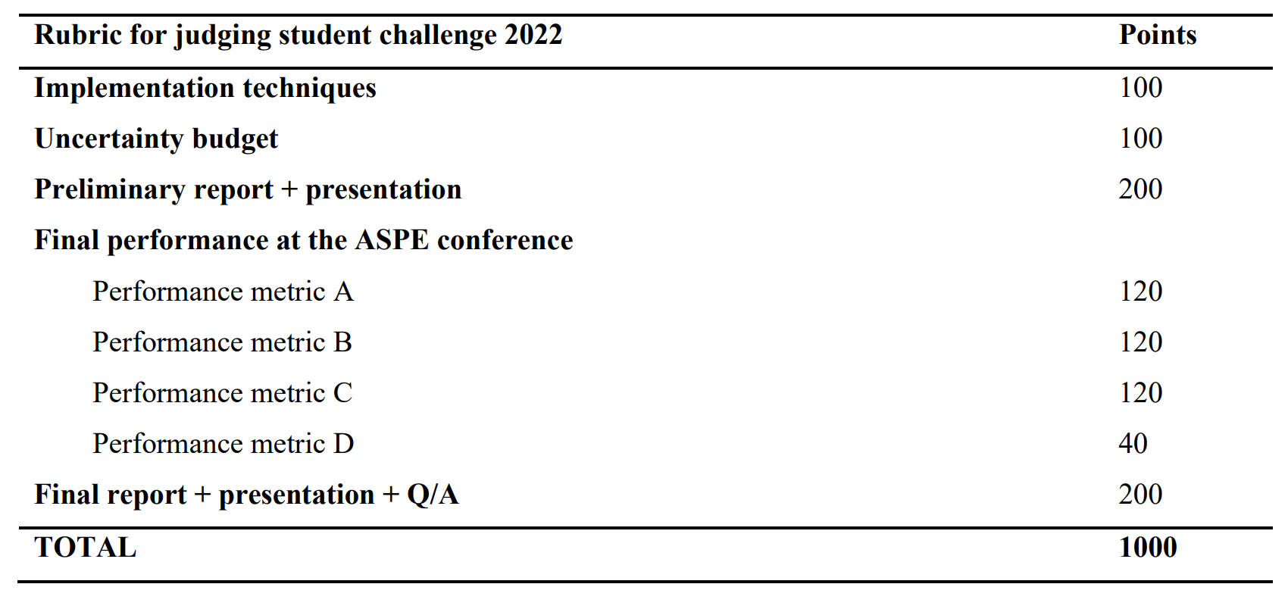
Key dates
Rubric
31-Aug
1-Sep
with an introduction presentation from the committee
16-Sep
and get real-time feedback. You will receive the scores the next week
https://aspe.net/programs/37th-annual-meeting/2022-student-challenge/

Slide 10
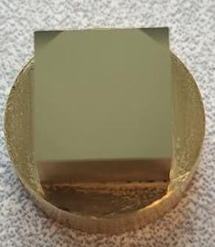
Preliminary presentation
conference deliverables
1. Teams are required to present their progress in getting the XY stages, and OPU operational.
2. The meeting will be held via Zoom on Sep 16, 2022, and the schedule for each team will be emailed. Committee will provide live feedback and address questions of individual teams.
3. A maximum of 200 points can be obtained and are based on:
Calibration of OPU travel
Measurement of central 0.5 mm² area of the concave mirror
Preliminary error Budget
Presentation of metrology efforts including well labeled images
Measurement routines/methods, sampling strategy and data processing
Overall presentation structure and quality
Three repeated measurement of two challenge Alvarez samples.
Measurement area should be 8 mm² including the two flat regions at the top edge. Each profile must be made with a lateral spacing of ≤ 0.04 mm.
Report the average time taken per areal measurement
Updated error budget by Oct 10th midnight
Presentation, and Q&A
(Flat regions are not present in the Team Alvarez sample)
Flat regions

Slide 11
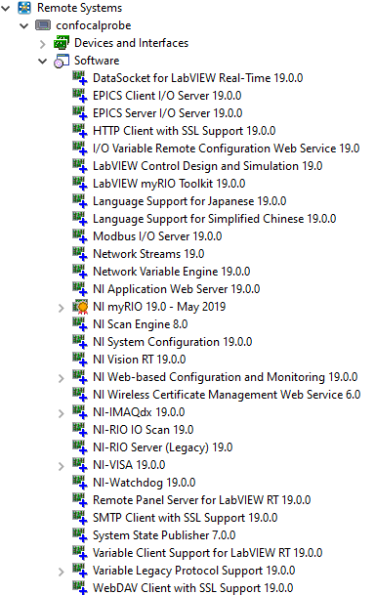
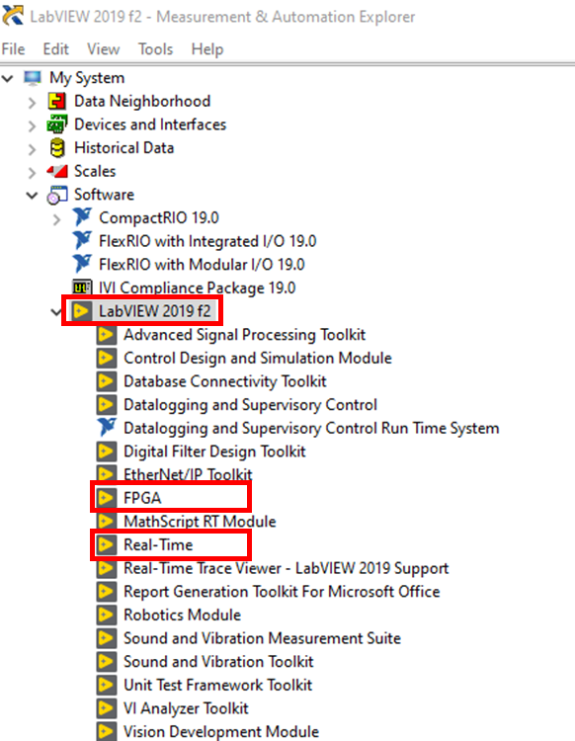
LabVIEW installation
A list of required software for myRIO can be found here, and LabVIEW myRIO software bundle contains all the required software.
To check the LabVIEW software and version installed on your PC and myRIO, open the NI MAX program on your PC. For software installed on the PC, navigate to My System > Software.
For software installed on the myRIO, ensure that the myRIO is connected to the PC, and navigate to Remote Systems > name of your myRIO > Software.
On your PC, in general
LabVIEW 2019 with FPGA and Real Time Modules
NI-RIO 19
On myRIO, in general
LabVIEW Real-Time 19.0.09
NI myRIO 19.0
Example list of NI software downloaded on the PC as shown in MAX. Indicated are the necessary modules.
List of NI software installed on the myRIO used during testing as shown in MAX. Some but possibly not all of these modules are necessary.

Slide 12
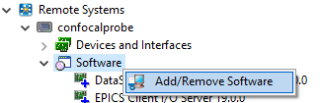
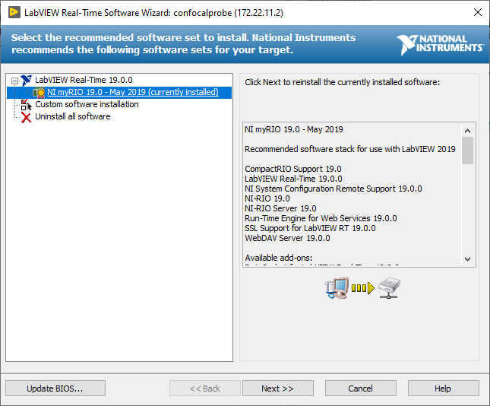
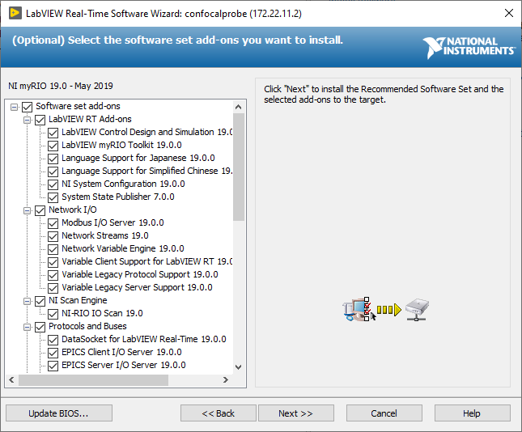
Installing software on the myRIO
Connect the myRIO to the PC. Open the NI MAX program. Navigate to Remote Systems > name of your myRIO > Software. Right click on Software and click Add/Remove Software.
Next, enter the device password for the admin user (likely blank) and select “NI myRIO 19.0” under the “LabVIEW Real-Time 19.0.0” tab. Click Next.
Click Next on the summary page and the software will be installed on the myRIO. The device may restart several times; expect the process to take several minutes.
Select all the software set add-ons, click Next.

Slide 13
Organizing committee
Luis A. Aguirre – 3M Company
Kumar Arumugam – NIST – Joint Quantum Institute
Neil Ball - Meta
Raymond C. Cady – Corning Inc.
Jacob Cole – IST precision
Liam G Connolly – UT Austin
Tim Dalrymple
Chunjie Fan – Corning Inc.
Mark T. Kosmowski – Electro-Scientific Industries, Inc.
Todd Noste – Lawrence Livermore national laboratory
Nilabh Roy – Canon Nanotechnologies
Stuart Smith – University of North Carolina at Charlotte
Alex Sohn – Meta
With contributions and consultant input from
Michael Cullinan - University of Texas, Austin
Michael Gomez – MSC industrial supply
Drew Devitt – New Way Bearings
Charles Perera – NASA, Goddard space flight center
Kent Queensland – Lion precision
Senajith Bandara Rekawa – Lawrence Berkeley Laboratories
Sourabh Saha – Georgia tech
Lei Zhou - University of Texas, Austin
aspe.challengecommittee@gmail.com
YouTube: ASPE Student challenge
GitHub

